Slide 1

Realize your
Machine Comprehension
Himanshu Arora
October 16, 2017
poten
Tial

Slide 2

Datasets

Slide 3
Types of RC tasks
Selecting an answer from multiple available choices (MCTest)
Filling a blank with a single word (CNN, CBT)
Selecting a span from the given passage (SQuAD)
Synthesize an answer from multiple passages (MS-MACRO)

Slide 4
SQuAD Leaderboard
Model | Research Paper | Date | F1
AIR-FusionNet (ensemble) | Not available | 20-Sep | 85.936
DCN+ (ensemble) | Older paper available with lesser score | 16-Aug | 85.619
Interactive AoA Reader (ensemble) | Available but limited to cloze-style tasks | 25-Jul | 85.297
r-net (ensemble) | Available | 1-Sep | 85.206
Model | Research Paper | Date
AIR-FusionNet (ensemble) | Not available | 20-Sep
DCN+ (ensemble) | Older paper available | 16-Aug
Interactive AoA Reader (ensemble) | Available but limited to cloze-style tasks | 25-Jul
r-net (ensemble) | Available | 1-Sep
Human performance: 86.8%

Slide 5
MS-MACRO Leaderboard
Model | Rouge-L | BLEU-1
S-Net | 45.23 | 43.78
R-Net | 42.89 | 42.22
ReasoNet | 38.81 | 39.86
Human performance: 47 and 46

Slide 6
R-NET
Implementation Available

Slide 7
The APPROACH
Match the question and passage with gated attention-based recurrent networks to obtain the question-aware passage representation
Use a self-matching attention mechanism to refine the representation by matching the passage against itself, which effectively encodes information from the whole passage
Employ pointer networks to locate the positions of answers from the passages.

Slide 8
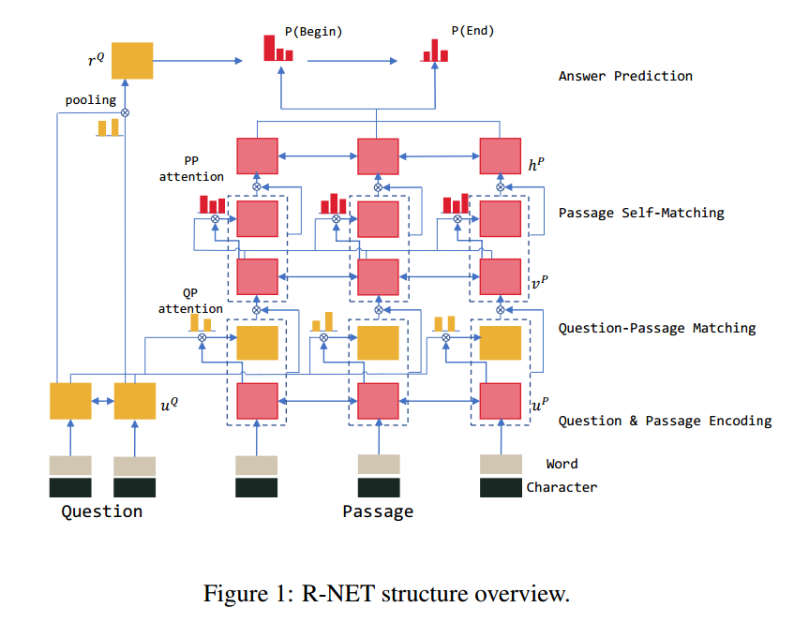
Structure

Slide 9
Question and PASSAGE ENCODER
Convert the words to their respective word-level embeddings and character-level embeddings.
The character-level embeddings are generated by taking the final hidden states of a bi-directional recurrent neural network (RNN) applied to embeddings of characters in the token.
Such character-level embeddings have been shown to be helpful to deal with out-of-vocab (OOV) tokens.

Slide 10
Gated Attention-BASED RNN
In attention-based RNN words in a passage with their corresponding attention-weighted question context are encoded together to produce question-aware passage representation.
R-NET adds an additional gate to this which assigns different levels of importance to passage parts depending on their relevance to the question, masking out irrelevant passage parts and emphasizing the important ones.

Slide 11
Self-Matching Mechanism
Recurrent networks can only memorize limited passage context in practice despite its theoretical capability.
Based on question-aware passage representation, gated attention-based recurrent networks on passage against passage itself is employed, aggregating evidence relevant to the current passage word from every word in the passage.
A gated attention-based recurrent network layer and self-matching layer dynamically enrich each passage representation with information aggregated from both question and passage, enabling subsequent network to better predict answers.
This information is then fed into the output layer to predict the boundary of the answer span.

Slide 12
Output Layer
R-NET uses pointer networks to predict the start and end position of the answer.
In addition, it uses an attention-pooling over the question representation to generate the initial hidden vector for the pointer network.

Slide 13
LINKS
Paper
TensorFlow implementation

Slide 14
Implementation Details
Tokenizer from Stanford CoreNLP
GloVe embeddings
Zero vectors for out-of-vocab words
1 layer of bi-directional GRU to compute character-level embeddings
3 layers of bi-directional GRU to encode questions and passages
The gated attention-based recurrent network for question and passage matching encoded bidirectionally
Hidden vector length is set to 75 for all layers
Hidden size used to compute attention scores is also 75
Dropout rate of 0.2 between layers
Optimized with AdaDelta with an initial learning rate of 1
The ρ and e used in AdaDelta are 0.95 and1e−6 respectively.

Slide 15
S-NET
Implementation Not Available

Slide 16
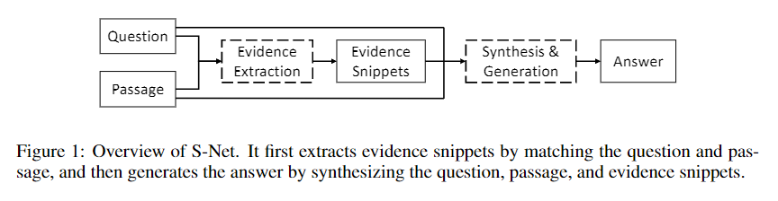
The APPROACH
Extraction-Then-Synthesis Framework
Predict the most important sub-spans from the passage as evidence
Rank passages to help answer extraction in multiple passages
Take the evidence as additional features along with the question and passage to synthesize the final answers.

Slide 17
Evidence Extraction

Slide 18
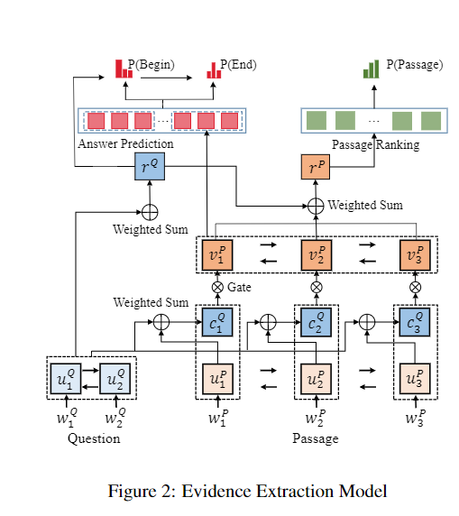
Structure

Slide 19
Evidence Snippet prediction
Convert the words to their respective word-level embeddings and character-level embeddings.
The character-level embeddings are generated by taking the final hidden states of a bi-directional GRU applied to embeddings of characters in the token.
Use a bi-directional GRU to produce new representation of all words in the question and passage respectively.
Generate sentence-pair representation via soft-alignment of words in the question and passage.
Use pointer networks to predict the position of evidence snippets.

Slide 20
Passage Ranking
In this part, we match the question and each passage from word level to passage level.
Use the question representation to attend words in each passage to obtain the passage representation.
The question representation and the passage representation are combined to pass two fully connected layers for a matching score.
For one question, each candidate passage has a matching score.
We normalize their scores and optimize the objective function.

Slide 21
ANSWER SYNTHESIS

Slide 22
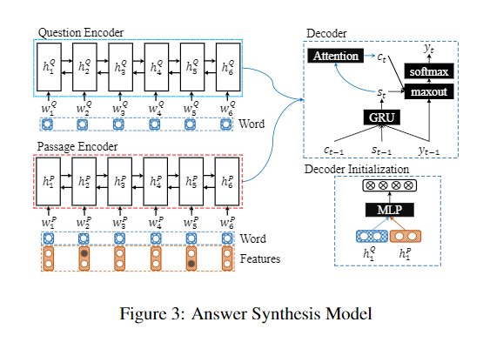
STRUCTURE

Slide 23
Answer Synthesis
Use the sequence-to-sequence model to synthesize the answer with the extracted evidences as features.
Produce the representation of all words in the passage and question respectively.
When producing the answer representation, combine the basic word embedding with additional features to indicate the start and end positions of the evidence snippet respectively predicted by evidence extraction model.
On top of the encoder, use GRU with attention as the decoder to produce the answer.
At each decoding time step, the GRU reads the previous word embedding and previous context vector as inputs to compute the new hidden state.

Slide 24
Answer Synthesis
To initialize the GRU hidden state, use a linear layer with the last backward encoder hidden state as input.
The context vector for current time step is computed through the concatenate attention mechanism, which matches the current decoder state with each encoder hidden state to get the weighted sum representation.
Combine the previous word embedding, the current context vector, and the decoder state to construct the readout state.
The readout state is then passed through a maxout hidden layer to predict the next word with a softmax layer over the decoder vocabulary.
Optimize the negative log-likelihood loss function.

